Slide 1
Canvas
Advanced Android Development
Lesson 11

Slide 2

11.1 The Canvas class

Slide 3
Contents
Drawing in Android
Introduction to Canvas
Simple drawing in response to user action
Using a Canvas in a custom view
Canvas operations
Clipping
Saving and restoring Canvas state
Summary

Slide 4
Drawing in Android

Slide 5
Drawing 2D custom graphics & animations
Drawables (earlier lesson)
Canvas (this lesson)
SurfaceView (later lesson)
Animations (later lesson)
Not covered:
Hardware acceleration
OpenGL

Slide 6
Introduction to Canvas

Slide 7

Why use a canvas?
Write to a canvas to accomplish more complex drawing than is possible with predefined Views

Slide 8
Canvas class
Canvas class—logical drawing surface for 2D drawing
Use Canvas when app needs to redraw regularly
onDraw() method runs on UI Thread
Clipping defines user-visible portions
Use Profile GPU Rendering tool to monitor performance of your drawing operations

Slide 9
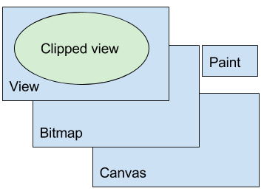
Classes required to draw
You need a View, a Bitmap, a Canvas, and a Paint object
View displays Bitmap
Bitmap is physical drawing surface
Canvas has API to draw on bitmap
Paint styles what you draw

Slide 10
Two approaches to draw to Canvas
2 ways to draw to canvas:
ImageView: Draw to canvas in the onClick handler Drawing can change when user taps the ImageView
Custom View: Draw to canvas in the onDraw() method Allows more complex user interaction
Notes:
High level list of the options. We look at each option in detail

Slide 11
Simple drawing in response to user action

Slide 12
Use a canvas in an ImageView
You can use an ImageView to draw to a canvas
Define ImageView's onClick handler to draw to the canvas
You need:
ImageView
Bitmap
Canvas
Paint

Slide 13
Custom drawing in an ImageView
Steps
Create an ImageView
Create a Paint object to set drawing style
Implement onClick handler for ImageView to draw to a canvas

Slide 14
Create ImageView in XML
<ImageView
android:id="@+id/myimageview"
android:layout_width="match_parent"
android:layout_height="match_parent"
android:onClick="drawSomething"/>
drawSomething() will draw to the canvas

Slide 15
Paint
Create Paint object
Stores how to draw: color, style, line thickness, text size
Paint object can persist outside onClick handler– no need to recreate it every time onClick triggers

Slide 16
Paint code example
private Paint mPaint = new Paint();
private Paint mPaintText =
new Paint(Paint.UNDERLINE_TEXT_FLAG);
mPaint.setColor(Color.RED);
mPaintText.setColor(Color.BLUE);
mPaintText.setTextSize(70);

Slide 17
onClick handler in the ImageView
Define onClick handler to draw to the canvas:
Create Bitmap
Associate Bitmap with ImageView
Create Canvas with Bitmap
Draw on Canvas
Call invalidate() on the View to force redraw

Slide 18

Example onClick code
mBitmap = Bitmap.createBitmap(
vWidth, vHeight, Bitmap.Config.ARGB_8888);
mImageView.setImageBitmap(mBitmap);
mCanvas = new Canvas(mBitmap);
mCanvas.drawColor(mColorBackground);
mCanvas.drawText(getString(R.string.my_string),
100, 100, mPaintText);
view.invalidate();

Slide 19
Using a Canvas object in a custom view

Slide 20
Use a custom View
Use a custom View to allow the drawing to change in response to more complex user interaction
Subclass one of the View classes
Override onDraw() and onSizeChanged() to draw
Override onTouchEvent() to handle user touches

Slide 21
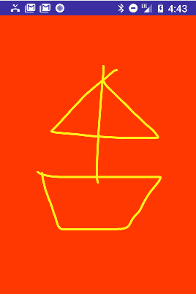
Example usage scenario
For example, user draws a picture on the canvas

Slide 22
Overview of steps to draw
Create Bitmap
Associate Bitmap with View
Create Canvas with Bitmap object
Use Paint for drawing style
Draw in onDraw()
Draw when size changes in onSizeChanged()
Call invalidate() on the View ...asks Android to redraw display

Slide 23
Create custom View class
Create a custom View class
Extend any View that has features you need
public class MyCanvasView extends View {...}

Slide 24
Use setContentView()
Set content View of activity to instance of custom View:
MyCanvasView myCanvasView;
myCanvasView = new MyCanvasView(this);
setContentView(myCanvasView);

Slide 25
Initialize Paint object
In constructor of the custom View:
Create Paint object and set initial properties
Initialize member variables
Get a reference to the context
Cannot create Canvas yet because uninflated View has no size

Slide 26
Paint code example
mPaint = new Paint();
mPaint.setColor(backgroundColor);
mPaint.setAntiAlias(true);
mPaint.setDither(true);
mPaint.setStyle(Paint.Style.STROKE); // default: FILL
mPaint.setStrokeJoin(Paint.Join.ROUND); // default: MITER
mPaint.setStrokeCap(Paint.Cap.ROUND); // default: BUTT
mPaint.setStrokeWidth(12); // default: Hairline-width

Slide 27
Create Bitmap in onSizeChanged()
In custom View, override onSizeChanged()
Create Bitmap
Create a Canvas with the Bitmap
Called when View is first assigned size, or its size changes
In onSizeChanged() calculate positions, dimensions, anything related to View size

Slide 28
onSizeChanged() example
@Override
protected void onSizeChanged(int width, int height,
int oldWidth, int oldHeight) {
super.onSizeChanged(width, height, oldWidth, oldHeight);
mBitmap = Bitmap.createBitmap(width, height,
Bitmap.Config.ARGB_8888);
mCanvas = new Canvas(mBitmap);
mCanvas.drawColor(mDrawColor);
}

Slide 29
Override onDraw() code
Can be simple or complex, must be fast, runs on UI Thread
@Override
protected void onDraw(Canvas canvas) {
super.onDraw(canvas);
canvas.drawBitmap(mBitmap, 0, 0, mPaint);
canvas.drawPath(mPath, mPaint);
}

Slide 30
Override onTouchEvent()
Drawing in response to user motion
In example below, invalidate() is inside the case statements because there are many other types of motion events passed into this listener, and we don't want to invalidate the view for those

Slide 31
Override onTouchEvent() code example
switch (event.getAction()) {
case MotionEvent.ACTION_DOWN:
touchStart(x, y);
break;
case MotionEvent.ACTION_MOVE:
touchMove(x, y);
invalidate();
break;
case MotionEvent.ACTION_UP:
touchUp();
invalidate();
break;

Slide 32
Example code
private void touchMove(float x, float y) {
float dx = Math.abs(x - mX); // distance moved
float dy = Math.abs(y - mY);
if (dx >= TOUCH_TOLERANCE || dy >= TOUCH_TOLERANCE) {
// QuadTo() adds a quadratic bezier from the last point,
// approaching control point (x1,y1), and ending at (x2,y2).
mPath.quadTo(mX, mY, (x + mX)/2, (y + mY)/2);
mX = x;
mY = y;
}
}

Slide 33
Canvas operations

Slide 34
What can you do on a canvas?
Fill Canvas with color
Draw shapes, such as rectangles, arcs, paths
Draw text styled by the properties in a Paint object
Style shapes and text using Paint objects

Slide 35
More canvas operations
Save and restore Canvas state
Apply transformations, such as translation, scaling, or custom transformations
Clip—apply a shape or path to define visible portions of Canvas

Slide 36
Filling Canvas with color
mCanvas.drawColor(mColorBackground);

Slide 37
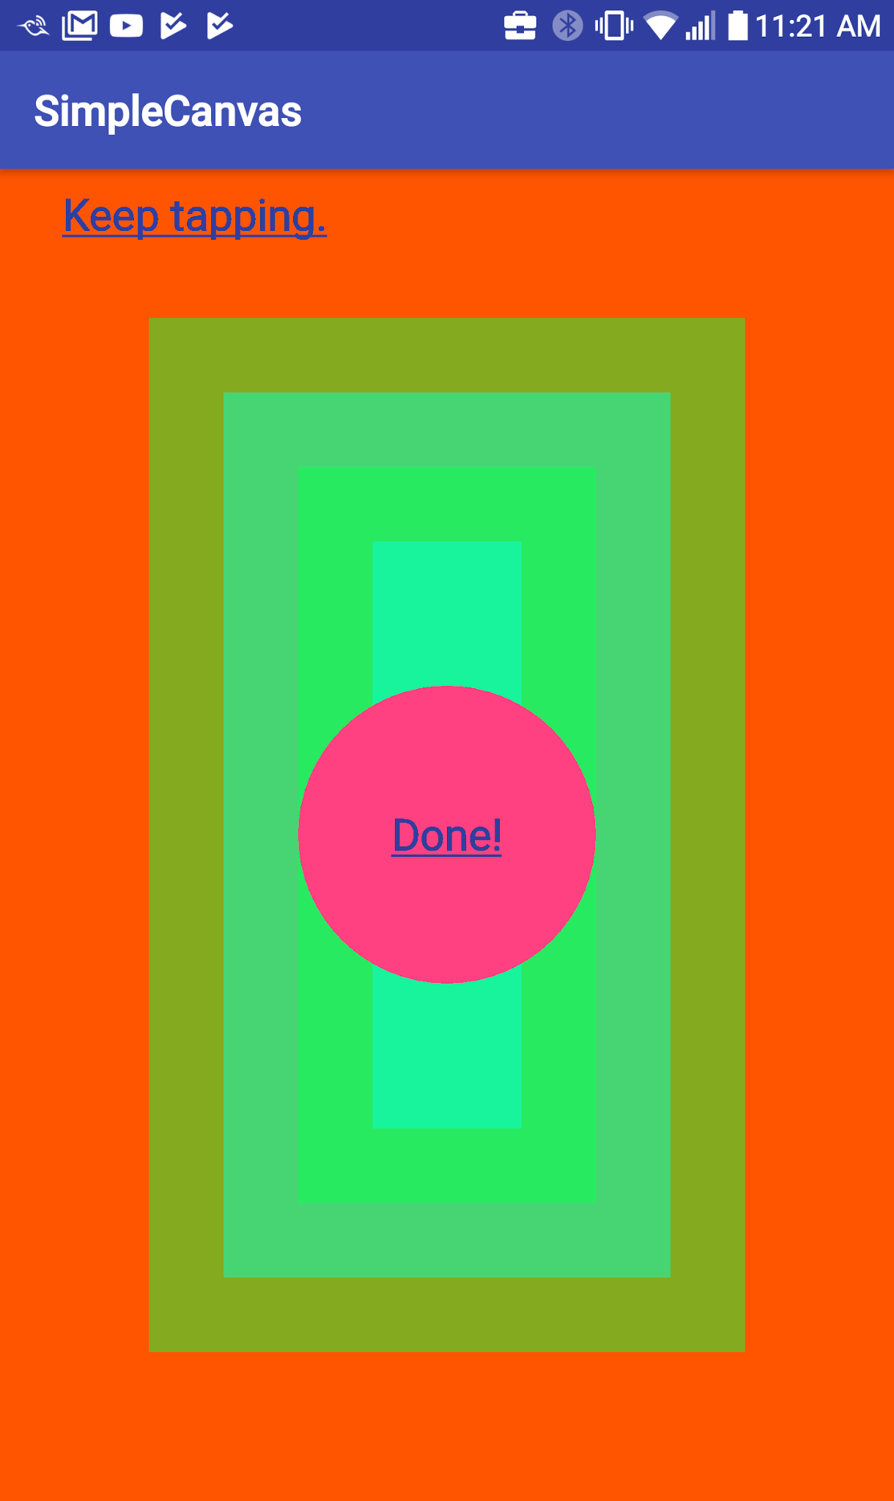
Drawing primitive shapes
Primitive shapes: drawRect(), drawOval(), drawArc()
Filled, outlined, or both: setStyle()
mPaint.setStyle(Paint.Style.FILL_AND_STROKE);
mCanvas.drawCircle (x, y, radius, mPaint);
mRect.set (x, y, width, height);
mCanvas.drawRect(mRect, mPaint);

Slide 38
Drawing complex shapes
Draw more complex shapes using the Path class
Define a shape by adding lines and curves to a Path object, then draw the shape using drawPath()
Paths can be outlined, filled, or both, depending on the setStyle()

Slide 39
Drawing text
Draw text using drawText()
Specify typeface using setTypeface()
Set text color using setColor()
mPaintText.setColor(textColor);
mPaintText.setTypeface(Typeface.DEFAULT_BOLD);
mCanvas.drawText(getString(R.string.keep_tapping), 100, 100, mPaintText);

Slide 40
Transformations: translate()
Use translate() to move the origin of the canvas
Use to draw the same shape in different locations
canvas.translate(dx, dy);

Slide 41
Transformations: rotate()
Use rotate() to turn the canvas by a number of degrees
canvas.rotate(180);

Slide 42

Transformations: skew()
Skew the canvas by calling the skew() method
You can achieve interesting text effects using skew()
canvas.skew(0.2f, 0.3f);

Slide 43
Combining transformations
mPaint.setTextSize(120);
canvas.translate(100, 1800);
canvas.skew(0.2f, 0.3f);
canvas.drawText("Transformed", 400, 60, mPaint);

Slide 44
Clipping

Slide 45
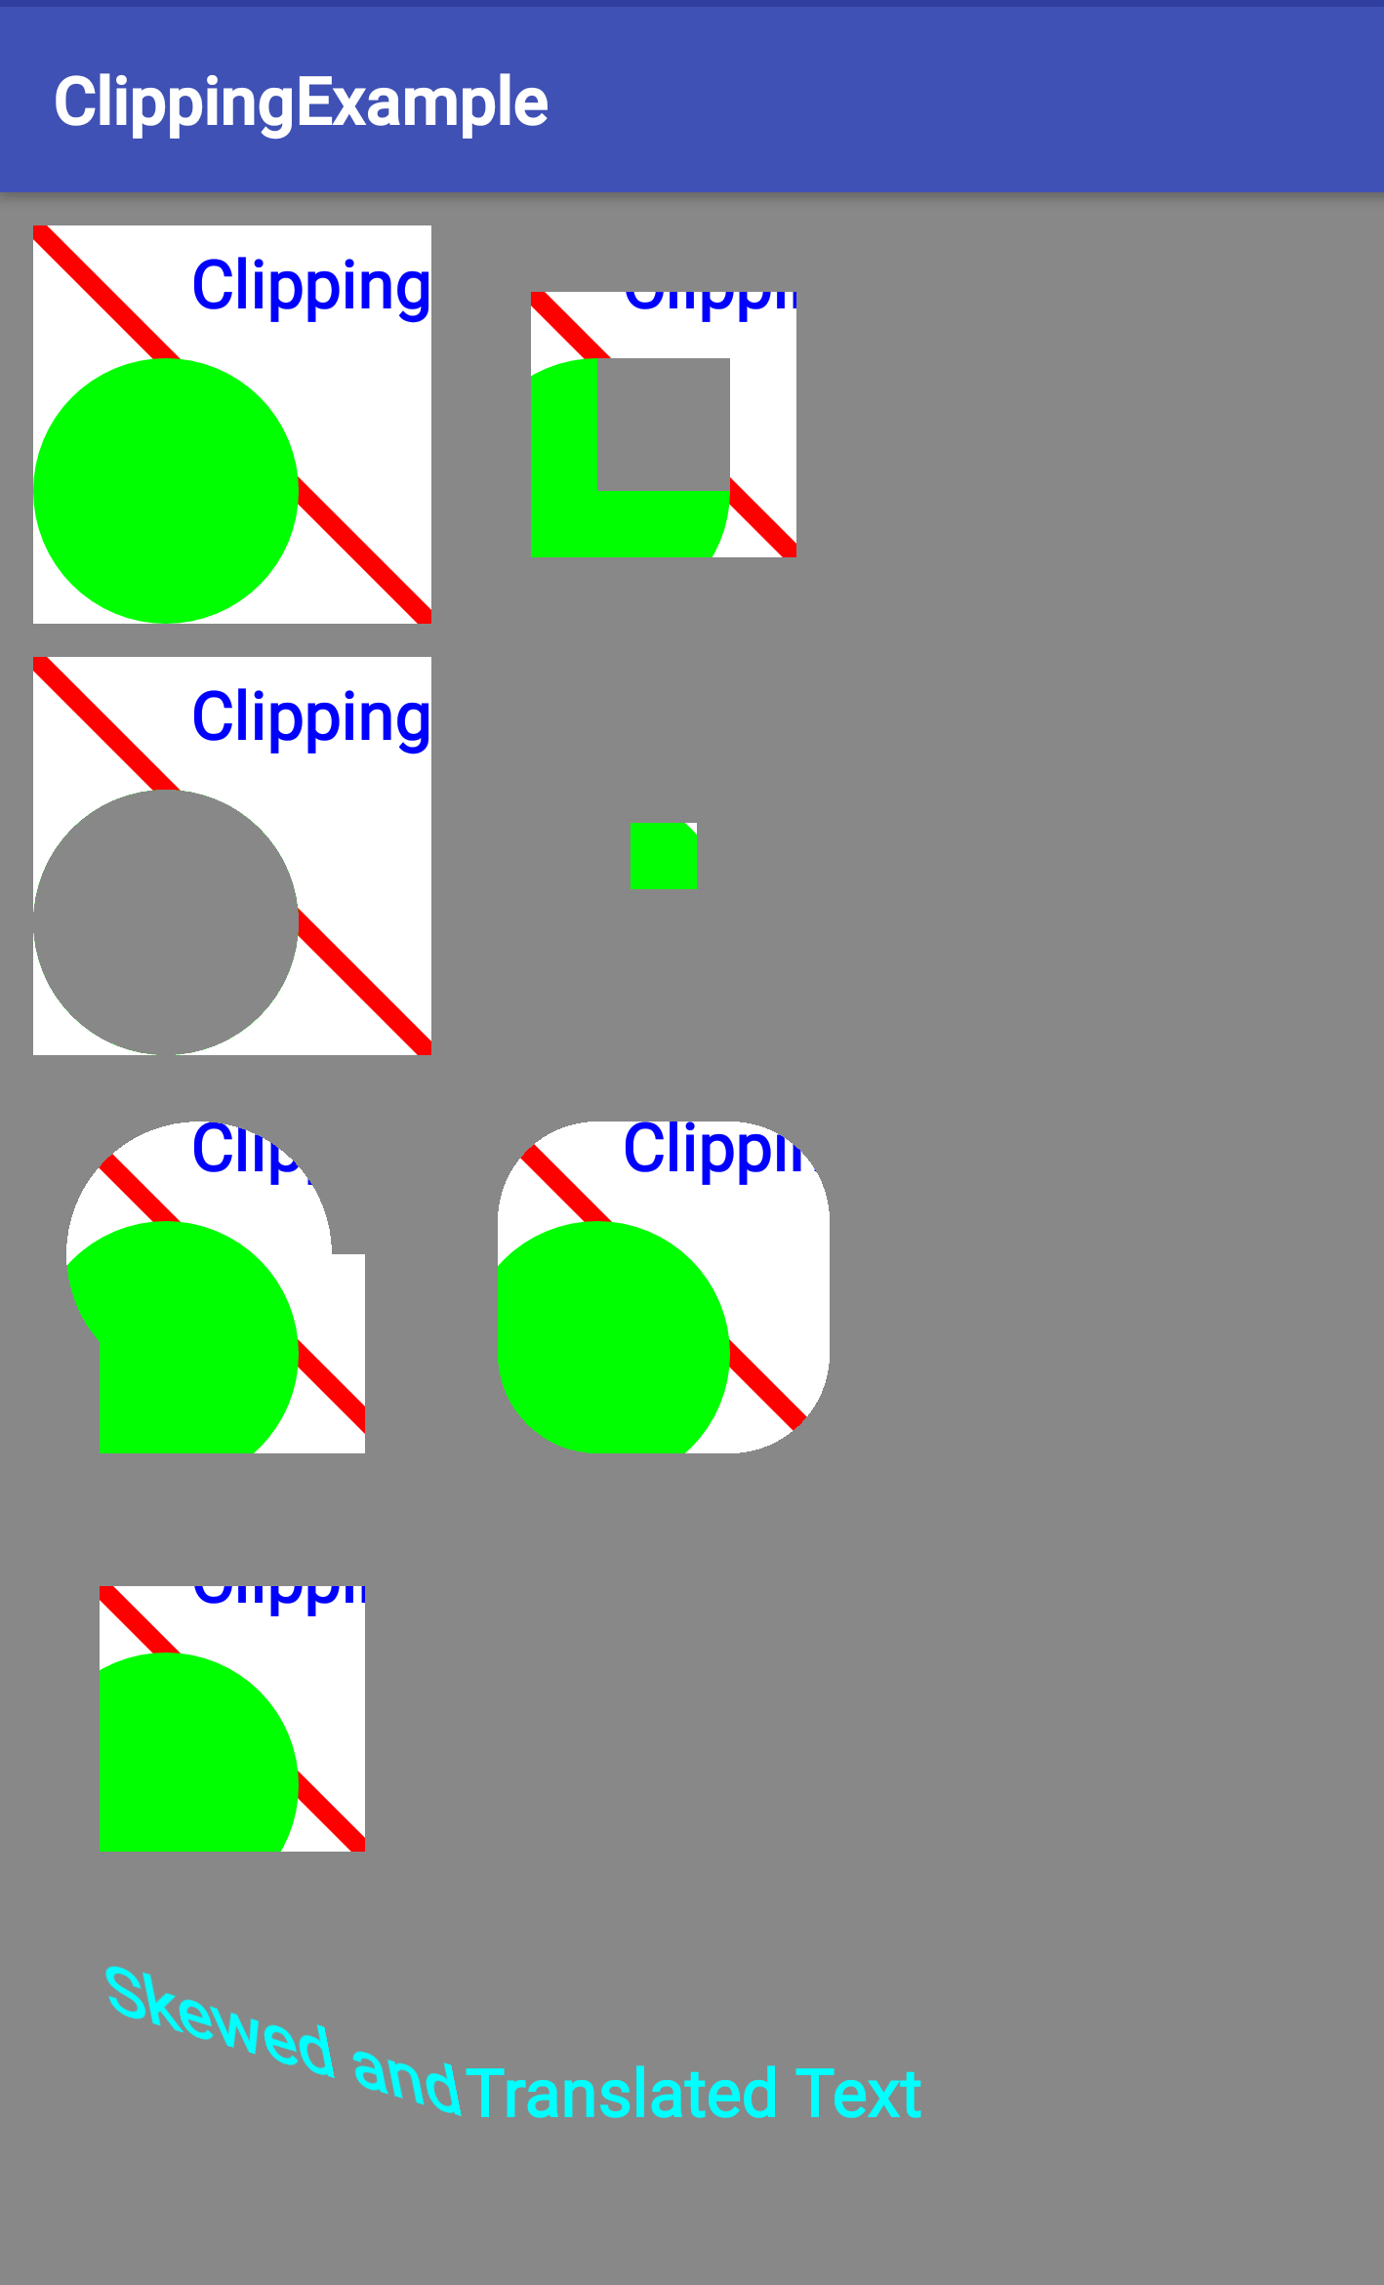
What is clipping?
Clipping is a way to define regions of an image, canvas, or bitmap that are drawn or not drawn onto screen
Reduce overdraw
Improve performance by drawing less
Create interesting UI effects and animation

Slide 46
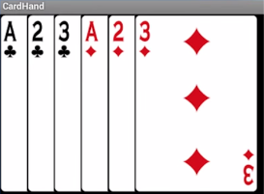

What is clipping good for?
Only draw visible portions of cards
Only show relevant parts of an image
Define clipping region of any shape

Slide 47
clipRect()
Use canvas.clipRect() to set a rectangular clipping region
canvas.clipRect(x, Y, right, bottom);

Slide 48
clipPath()
Use canvas.clipPath() for a custom clipping region:
mPath.addCircle(radius, x, y, Path.Direction.CCW); canvas.clipPath(mPath, Region.Op.DIFFERENCE);
CCW means draw circle counterclockwise
Region.Op.DIFFERENCE indicates how to apply region to canvas

Slide 49
quickReject()
quickReject() checks whether a specified rectangle or path would lie completely outside the currently visible regions, after all transformations have been applied
Decide efficiently which objects you do not have to draw at all

Slide 50
Complex clipping
Combine or intersect multiple clipping regions

Slide 51
Saving and restoring

Slide 52
Stack of drawing states
Activity context maintains stack of drawing states
Each state includes currently applied transformations and clipping regions
You can't remove clipping regions
Undoing a transformation by reversing it is error-prone

Slide 53
Saving and restoring
Save the state of the Canvas using save()
Apply transformations
Draw
Restore previous Canvas state using restore()

Slide 54
Saving and restoring
canvas.save();
mPaint.setTextSize(120);
canvas.translate(100, 1800);
canvas.skew(0.2f, 0.3f);
canvas.drawText("Skewing", 400, 60, mPaint);
canvas.restore();
canvas.save();
mPaint.setColor(Color.CYAN);
canvas.translate(600, 1800);
canvas.drawText("Save/Restore", 400, 60, mPaint);
canvas.restore();

Slide 55
Summary

Slide 56
Canvas summary
You need a View, a Canvas, a Paint , and a Bitmap object
The Bitmap is the physical drawing surface. The Canvas provides an API to draw on the Bitmap, the Paint is for styling what you draw, and the View displays the Bitmap
You create a Bitmap, associate it with a View, create a Canvas with a Paint object for the Bitmap, and then you can draw
You must invalidate() the View when your are done drawing, so that the Android System redraws the display
All drawing happens on the UI thread, so performance matters

Slide 57
Clipping summary
The Context of an Activity maintains a state that preserves transformations and clipping regions for the Canvas
Use canvas.save() and canvas.restore() to draw and return to original state of your Canvas
To draw multiple shapes on a Canvas, either calculate their location or move (translate) the origin of your drawing surface; the latter can make it easier to create utility methods for repeated draw sequences
Clipping regions can be any shape, combination of shapes, or path
Add, subtract, and intersect clipping regions to get exactly the region you need
You can apply transformations to text

Slide 58
What's next?
Concept chapter: 11.1 The Canvas class
Practicals:
11.1A Creating a simple Canvas object
11.1B Drawing on a Canvas object
11.1C Applying clipping to a Canvas object

Slide 59
END

